Slide 1
CSSSKL 342 Programming in C++
Lab01
Jim Hogg
Email: jimhogg@uw.edu
We will start Zoom session at 1:15

Slide 2
Admin

Slide 3
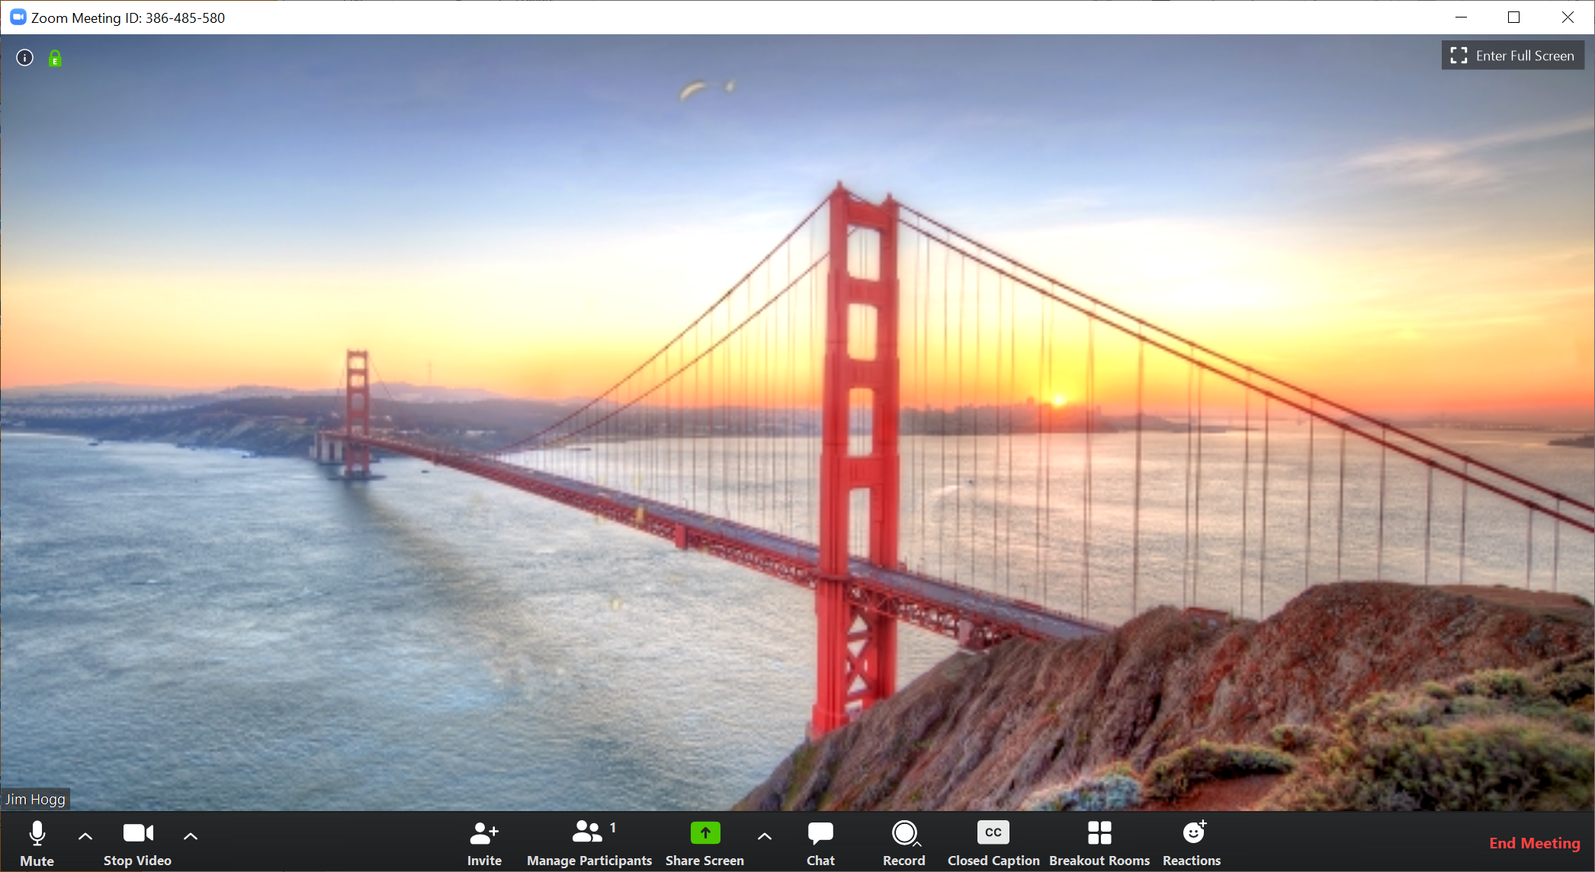
Zoom
Mute
Stop Video
Ask questions in Chat
Participants
Yes, No, Ask
Reactions
Share Screen

Slide 4
Admin
CSSSL-342 : “Programming With Object-Oriented Languages”, or:
“Programming in C++”
5-week intensive ramp-up on C++
All you need for CSS-342 : “Data Structures & Algorithms”
Assumes you already know some OO language, such as Java or C#
Instructor: Jim Hogg - jimhogg@uw.edu
Classes: Fridays, 13:15 - 17:15 pm, online via Zoom
Office Hours: Fridays 12:00-13:00, or by appointment, via Zoom
Assignments: due by midnight, Sunday

Slide 5
More Admin
Communication: we will use Canvas for everything – Slides, Assignment, Announcements, Grading, Email, Discussions, Code, etc
We shall cover:
All the C++ you need for CSS-342 (Data Structures & Algorithms)
Help yourselves by:
Asking questions at any time; don’t delay, thinking it will all fall into place: it won't
Ask me to go slower (or faster)
Ask me to cover topics you are finding troublesome
Zoom in to Office Hours
Read along in the textbook and/or online
Learn by Doing: write code and experiment

Slide 6
Grading
The class is Pass or Fail. Nothing in-between. No exam. Doesn't affect your GPA.
What do you need to do to pass?
Attend each lab
Work diligently thru the exercises
Submit results to Canvas for grading
Don’t need to get answers 100% correct, but you need to try!
Achieve 75% average
Do you need to stay all 4 hours?
I will show a few slides, and introduce exercises during the 4 hours
You must stay on Zoom for first 2 hours
May leave Zoom afterwards to work in private (but you may miss some explanations)

Slide 7
Who Am I?
Jim Hogg
Part-time Lecturer
Previous
Microsoft: .NET and C++ Compiler Redmond 20 years
Digital (DEC): VMS Operating System Edinburgh 12 years
Oil Exploration Software London 4 years
Computational Physics London 6 years
BSc Physics, MSc Computer Science Edinburgh

Slide 8
Books & Other Reading

Slide 9
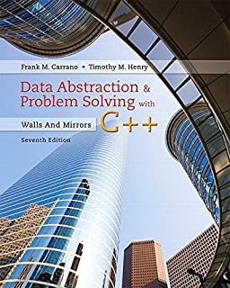
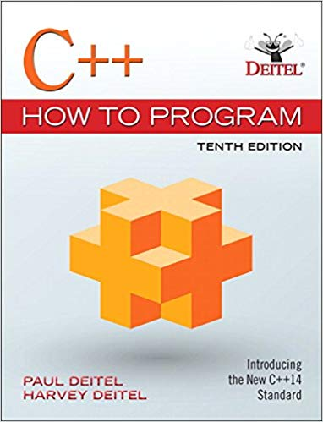
Books & Background Reading
Data Abstraction & Problem Solving with C++
“Walls & Mirrors”
Carrano, 7th Edition
Same as used for CSS-342
This one should be all you need. Outstanding book
C++ How to Program
Deitel, 10th Edition
Lots of exercises
If you want more practice. Gentle style. Thousands of exercises.

Slide 10
If You Get Stuck
http://www.cplusplus.com/
Large website. Definitive. Trustworthy
https://stackoverflow.com/
“For developers, by developers” – always good advice
https://isocpp.org/faq, or https://www.parashift.com/c++-faq/
Online book – great for point-wise Q & A
I usually Google my question. Numbers 1 and 2 above always come near the top of the list. Beware other websites: some are just plain wrong

Slide 11
Syllabus

Slide 12
Syllabus for CSSSKL-342
Content is based loosely on the “C++ Interludes” in the "Walls & Mirrors" textbook.
But we skip some topics, and change the order – so as to cover what you need, when, for CSS-342
This class is designed to help you through CSS-342, not to make you C++ gurus. So ask about any C++ features you find confusing (there are many!), and I will shape the syllabus to match
Features in C++ you will not need for CSS-342: inheritance (so no virtuals), asserts, exceptions, smart pointers, iterators, macros, inline assembly, etc

Slide 13
Topics for Today
Setting up
Functions & IO (cin, cout, endl)
ByVal, ByRef
Classes : basics

Slide 14
Setting up your "Development Environment"

Slide 15
Setting up your Development Environment
For CSSSKL-342, choose whichever development environment you prefer. So long as you can upload your solution files to Canvas:
Your own Windows PC. Pick your favorite IDE. I use Code::Blocks
Your own Windows PC. Use editor and command-line tools. For the brave
Your own MAC. Use XCode
https://repl.it Web-based. Very easy: no files to download, or programs to install
Linux Cluster in building UW1. Command-line tools. Welcome to 1990.
For CSS-342, I believe you can develop solutions however you like. But they must work on Linux, for grading purposes. Check with your CSS-342 teacher.

Slide 16
Setting Up for Linux
https://github.com/pisanorg/w/wiki/setting-up-your-development-environment
https://github.com/pisanorg/w/wiki/css-linux-lab
https://github.com/pisanorg/w/wiki/unix
https://github.com/pisanorg/w/wiki/50-step-unix
http://depts.washington.edu/cssuwb/wiki/connecting_to_the_linux_lab
If you choose to use the Linux cluster, the instructions on this page may help. Read this slide later, at your leisure.
Or create an account on repl.it, using your uw.edu email:
https://repl.it

Slide 17
Reaching Linux from Windows : All You Need
Login to the Linux cluster: ssh netid@csslabN.uwb.edu (N is 1 thru 12)
Create source file: eg: nano hello.cpp
Compile hello.cpp: g++ -std=c++11 hello.cpp
Run program: ./a.out
Pull myfile.txt from Linux: scp netid@csslab7.uwb.edu:myfile.txt c:\tmp\
Push myfile.txt to Linux: scp c:\tmp\myfile.txt netid@csslab7.uwb.edu:
The above works if you are on-campus. If not, use Husky OnNet to connect:
https://itconnect.uw.edu/connect/uw-networks/about-husky-onnet/use-husky-onnet/

Slide 18
Linux Commands : How to Scrape By
mkdir Test
cd Test
nano hello.cpp
g++ -std=c++11 hello.cpp
./a.out
ls
cp hello.cpp hi.cpp
rm hello.cpp
cd ..
make a new directory called Test. Linux is case-sensitive!
change working directory to Test
use some editor (eg: nano) to edit source file
compile hello.cpp - output file, by default, is called "a.out"
execute the program
list files in current directory
copy hello.cpp into hi.cpp
remove (delete) hello.cpp
change working directory to the level above

Slide 19
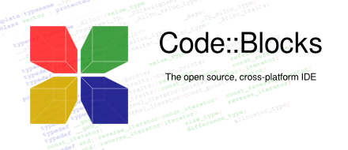

Code::Blocks on Windows
I use Code::Blocks. It's free. It works on Windows and Linux. It's simple, and mostly works
https://www.fosshub.com/Code-Blocks.html?dwl=codeblocks-17.12mingw-setup.exe
Click on "Code Blocks Windows Installer (GNU C/C++ Compiler and Debugger)" - 86 MB
This will download the file codeblocks-17.12mingw-setup.exe
Double-click on this file. Accept all defaults. Ready in about 1 minute

Slide 20
C++ Functions

Slide 21
Task 1 : Add.cpp
Add.cpp
#include <iostream> using namespace std;
int add(int a, int b) {
return a + b;
}
int main() {
int x; // first number
int y; // second number
cout << "Add two numbers" << endl << endl;
cout << "Please input first number ";
cin >> x;
cout << "Please input second number ";
cin >> y;
int z = add(x, y);
cout << "Their sum is " << z << endl;
return 0;
}
In C++ we can create functions at ‘top-level’. No need for every function to be inside a class.
Copy this code into a file called Add.cpp. Or download a copy from Canvas at Files|Lab01|Add. Build and run the program.
Note: I am using the Code::Blocks IDE. If you look at Files|Lab01|Add for example, in includes Add.cpp and two others: Add.cbp and Add.layout. If you are also using Code::Blocks, then you can download all 3 files: double-click on Add.cbp (CodeBlocksProject file) and it will open the project. You are then “good to go”

Slide 22
Notes
Copy the library “header” file called “iostream” into our source file.
Add.cpp
#include <iostream> using namespace std;
int add(int a, int b) {
return a + b;
}
int main() {
int x; // first number
int y; // second number
cout << "Add two numbers" << endl << endl;
cout << "Please input first number ";
cin >> x;
cout << "Please input second number ";
cin >> y;
int z = add(x, y);
cout << "Their sum is " << z << endl;
return 0;
}
Avoids having to say std::cout later
One of only 2 legal C++ main signatures
cout writes to the console
endl = end line (\n)
cin reads use input. Automatically converts text to variable type
function call
This is not a bitwise left-shift!

Slide 23
Task 2 : AddLoop.cpp
Extend Add.cpp by creating a loop in main so that it repeats forever: ask for two numbers, add them, display result
Call your new file, AddLoop.cpp
Submit AddLoop.cpp

Slide 24
Task 3 : ArithLoop.cpp
Extend AddLoop.cpp by adding functions to add, subtract or multiply two numbers. As well as asking the user for their two numbers, ask which operation they want done.
Call your new file ArithLoop.cpp
Submit ArithLoop.cpp

Slide 25
Task 4 : ArithLoopReal.cpp
Extend ArithLoop.cpp by accepting real numbers, rather than integers. (Use float or double)
Call your new file ArithLoopReal.cpp
Submit ArithLoopReal.cpp
What if the user types in something that’s not an integer – eg: abcde
What happens? How would you validate the user’s input?

Slide 26
Task 5 : ValidateInput.cpp
#include <iostream>
using namespace std;
int main() {
int x;
while (true) {
cout << "Enter a number ";
cin >> x;
if (cin.fail()) {
cout << " Nope, that's not an integer" << endl;
cout << " Let's try that again" << endl;
cin.clear(); // clear the error flag on cin
cin.ignore(100, '\n'); // ignore rest of input line
} else {
break;
}
}
cout << "You entered the integer " << x << endl;
return 0;
}
Type this code into Validate.cpp, or download from Canvas at Files|Lab01|ValidateInput
Invalid int
Try this out.
What if the user types 123abcde?
What if user insert leading spaces or tabs? eg: “ 456 “ ?
Ignore up to 100 chars or until we hit ‘\n’ (end of line)

Slide 27
ByVal & ByRef

Slide 28
ByRef versus ByVal
y is passed by reference. changer is given a ‘pointer’ to main’s variable b. When changer alters its y, it is really altering the caller’s variable; not a local copy of y
Changer.cpp
#include <iostream>
using namespace std;
void changer(int x, int& y) {
x = x + 1;
y = y + 1;
}
int main() {
int a = 4;
int b = 5;
cout << "Before: a = " << a << " and b = " << b << endl;
changer(a, b);
cout << "After: a = " << a << " and b = " << b << endl;
return 0;
}
x is passed by value. changer is given a copy of x, whose value is 4. We can change its value within changer, but these changes are NOT affecting the caller’s variable (a)
Note: you cannot do this in Java. You can in C#, using the ref keyword

Slide 29
Task 6 : ByRef.cpp
Based upon the Changer.cpp example, write a file called ByRef.cpp.
It should ask the user for two int variables. Then call a function that takes the two variables as inputs (pass by-value), and passes two results back to the caller, using by-reference parameters: the integer divisor, and the integer remainder.
Submit ByRef.cpp
Here is a short test program, where we have called our function "divrem"
int main() {
int div; // divisor
int rem; // remainder
divrem(17, 3, div, rem);
cout << "div = " << div << " rem = " << rem << endl;
}

Slide 30
int main() {
int div = 0;
int rem = 0;
divrem(12345, 29, div, rem);
cout << div << “ “ << rem << endl;
}
ByRef – What’s Going On?
A byref (&) behaves as if it pointed back to the caller’s memory location. It is not a simple copy of the argument value.
Memory for divrem
12345
29
a
b
div
rem
void divrem(int a, int b, int& div, int& rem) {
div = a / b;
rem = a % b;
}

Slide 31
C++ Classes

Slide 32
Point.cpp
#include <iostream>
using namespace std;
class Point {
private:
float x; // x coordinate
float y; // y coordinate
public:
Point() { }
Point(float xx, float yy) { x = xx; y = yy; }
void add(Point& other) {
x += other.x;
y += other.y;
}
void show() {
cout << "(" << x << ", " << y << ")" << endl;
}
};
Java | C++
field, attribute | data member
method | member function
Subsequent lines are in the private section of this class
Default (no parameter) constructor
2-parameter ctor
method
int main() {
Point p(2.0, 3.0); p.show();
Point q(4.0, 5.0); q.show();
p.add(q); p.show();
return 0;
}

Slide 33
Task 7 : PointRad.cpp
Type Point.cpp from the previous slide into your own file and call it PointRad.cpp. Or download from Canvas, at Files|Lab01|Point. Run the program to make sure it works.
Add a method called radius that returns the distance from the origin to the current Point.
Hint: you will need to add the line: #include <cmath> to reach the function sqrt
Add a test to main to check that radius works correctly.
Call your file PointRad.cpp, and submit it.

Slide 34
Task 8 : PointDist.cpp
Extend your previous PointRad.cpp by adding a method, called distance, that calculates the distance between two Points – ie, between the current Point and another, supplied Point.
Add a test in main that checks your distance method works correctly.
Call your new file PointDist.cpp and submit it.

Slide 35
Task 9 : Area.cpp
Extend your previous PointDist.cpp by adding a method, called area, that calculates the area of the triangle formed by corners: the origin, the current Point and another, supplied Point.
Use Heron’s formula. Check its definition using Google.
Add a test in main that checks your area method works correctly.
Call your new file Area.cpp and submit it.

Slide 36
If You Want More Practice
Go to https://www.cprogramming.com/
Online version of a book on C++ (and C) by Alex Allain. Outstandingly good!
Click on "Practice Problems". Work your way thru each problem below:
Fill in the blank exercises
Fill in the missing parts of the code to create a working program that will accomplish the stated task.
Array input and output
Guessing game
Calculator
Basic Programming Challenges
Temperature Converter - Celsius to Farenheit
Count the number of lines in a file
Determine the size of a file
Find all permutations of a given input

